Slide 1


PERSONAL FINANCE MANAGEMENT SYSTEM
Done By:
Sufyan Shadab
Shuayb Dawood
Naina Dhawan
Ithihas k.s
Vishnu Prasad S

Slide 2

INTRODUCTION
The Personal Finance Management System is designed to empower individuals to take charge of their finances by making the process of tracking income, expenses, and savings easier. It fosters financial literacy, good spending habits, and helps users set and track budgets with better planning. Designed to meet the core issues that face people in handling their money, the system provides an easy-to-use and accessible tool through which to organize finances and identify savings opportunities and means for achieving their financial goals. It is also an education project, demonstrating how fundamental programming concepts can effectively solve real-world problems.

Slide 3

MOTIVE
Managing personal Finances forms a very crucial part of contemporary living. However, most people still do not know how to record their income, expenses, and savings effectively. The Personal Finance Management System is a simple, easy-to-use program designed to solve this problem.

Slide 4
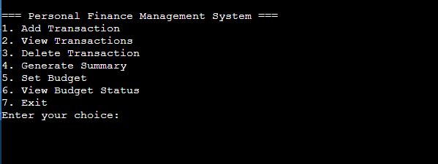
USER INTERFACE
Main menu: -

Slide 5



Add Transaction: -
View Transaction: -
Generate Summary: -

Slide 6



Set budget: -
Budget status
Delete Transaction: -

Slide 7
Exit

Slide 8

METHODOLOGY AND WORKFLOW
Methodology
Problem Analysis - To create a tool that tracks income, expenses, budgets, and financial summaries effectively.
User interaction – The program takes in valid user input such as transaction type, budget limit, transaction amount, and so on. Also displays a menu to guide the users.
Data Management - Transaction Data such as IDs, types (Income/Expense), categories (e.g., Food, Rent), and amounts. Budget Data, categories and associated budget limits. Efficient indexing ensures seamless addition, deletion, and retrieval of data.
Process - Store transactions in arrays for type, category, and amount. Perform operations like adding, deleting, and viewing transactions. Summarize financial data by calculating totals and comparing with budgets.
This methodology follows a systematic approach to achieve its objectives on simplifying financial management.

Slide 9
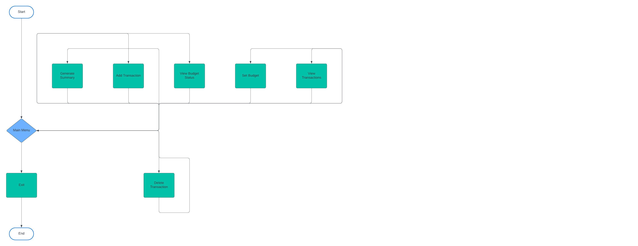
Work flow: -

Slide 10
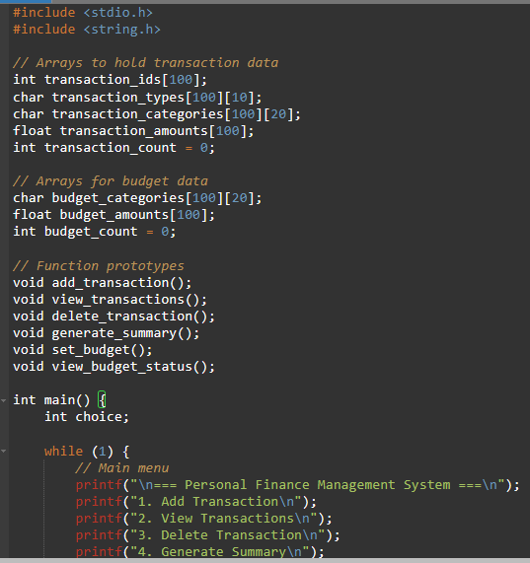
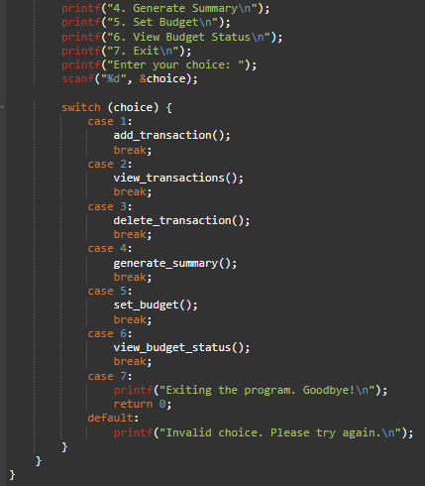
CODE

Slide 11
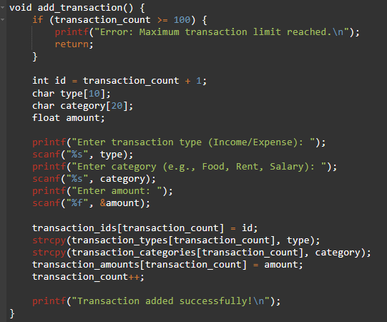
To add transaction :-

Slide 12
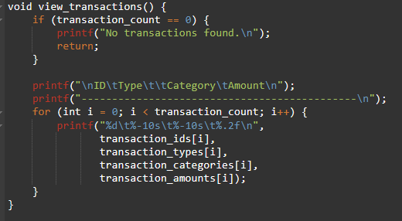
To view all transactions :-

Slide 13
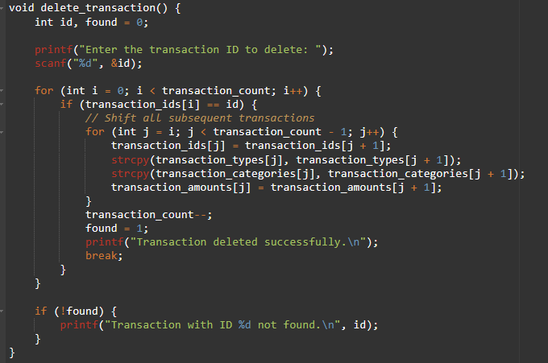
To delete transactions :-

Slide 14
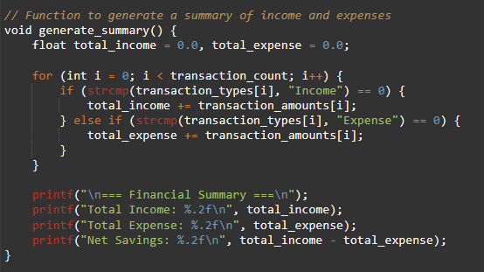
To generate summary :-

Slide 15
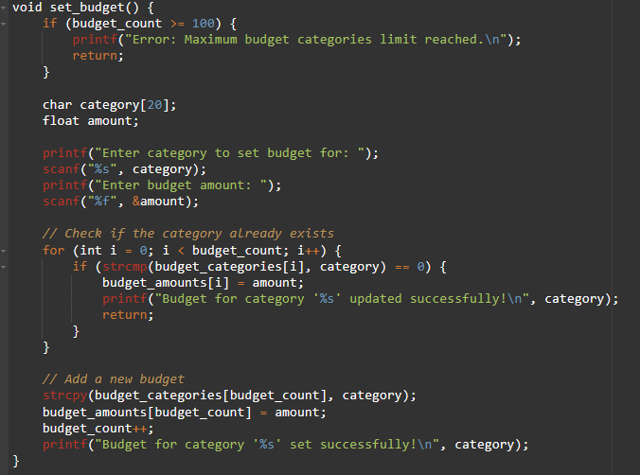
To set a budget :-

Slide 16
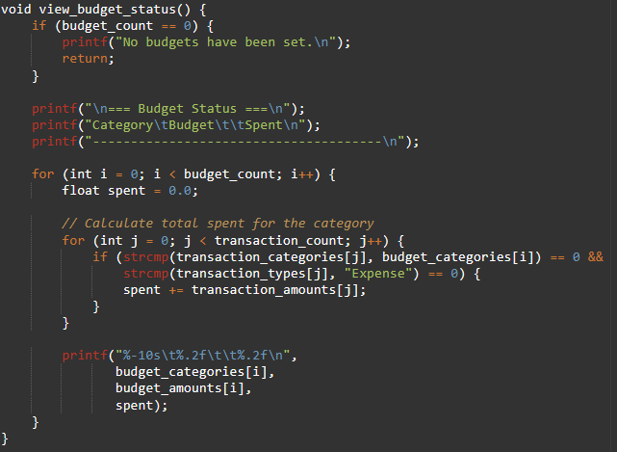
To Check budget status : -

Slide 17
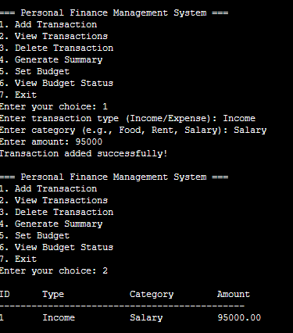
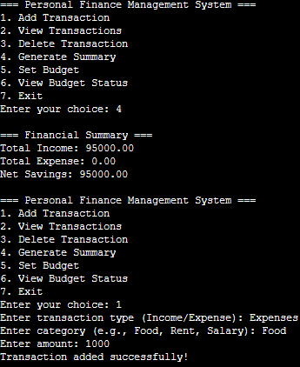
OUTPUT

Slide 18
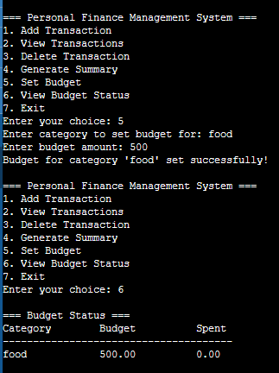
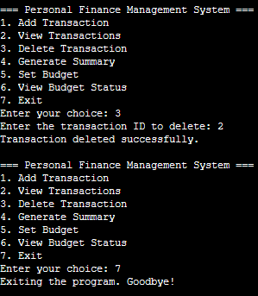

Slide 19

THANK YOU

